Slide 1


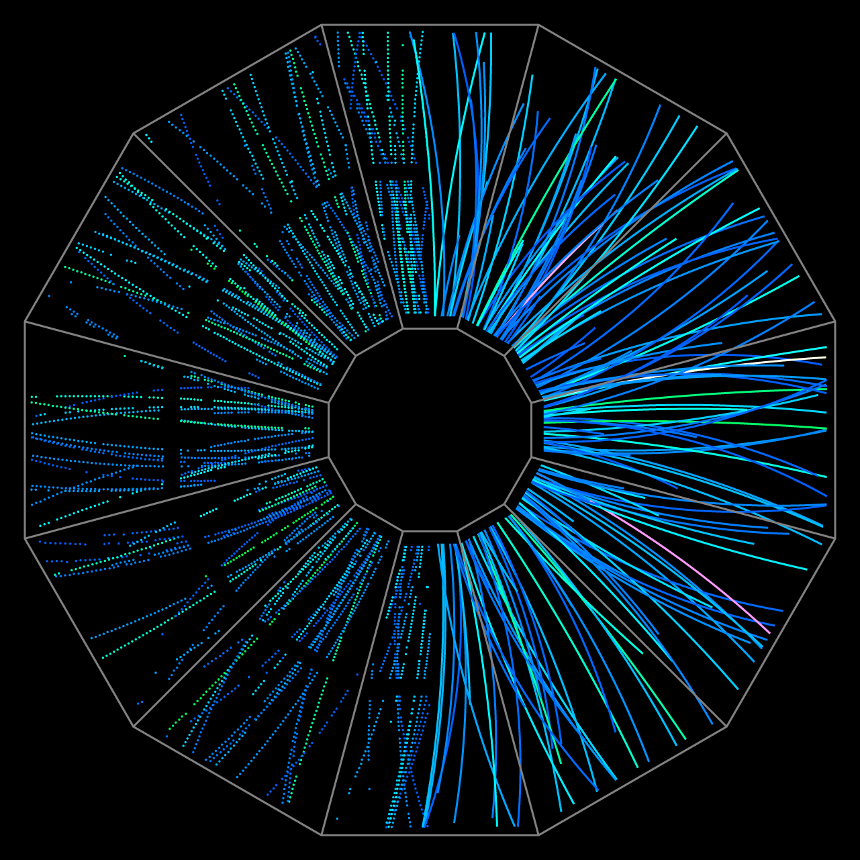

Looking into the QGP
Diptanil Roy
Rutgers University
roydiptanil@gmail.com
Monday, January 30, 2023
Notes:
Good morning, everyone. I am Diptanil Roy from Rutgers and today I will be presenting a preliminary study on the flavor dependence of jet shape modifications in the presence of Quark Gluon Plasma, on behalf of the STAR Collaboration. I will start with the motivation for this study, and then talk briefly about the STAR experiment. Then I will discuss some initial findings about heavy flavor jets in heavy ion collisions.

Slide 2
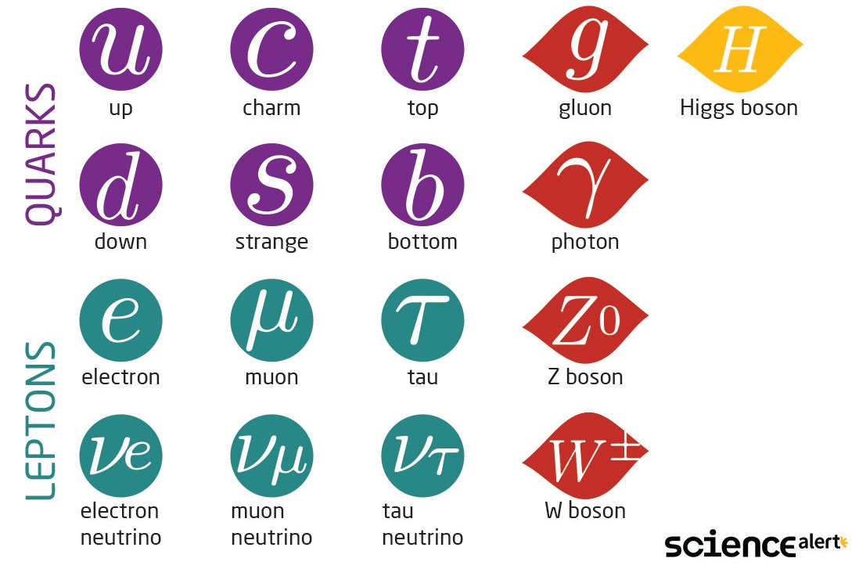
Outline
Quark Gluon Plasma
Bulk Probes
Critical Point
Anisotropic Flow
Hard Probes
Jets
Heavy Flavor
Heavy Flavor Jets

Slide 3

Quark-Gluon Plasma (QGP)
Temperature ~ 10¹² K
Notes:
In normal matter , quarks and gluons are bound at all times. The only way to get quarks and gluons separately in a system is by increasing temperature and/or pressure. This is due to asymptotic freedom, which posits that the interaction between quarks and gluons becomes weak at such high energies, and allows them to become unbounded. This gives rise to a new form of matter known as the Quark Gluon Plasma. Temperatures in the quark gluon plasma medium can reach the order of 10^12 K

Slide 4
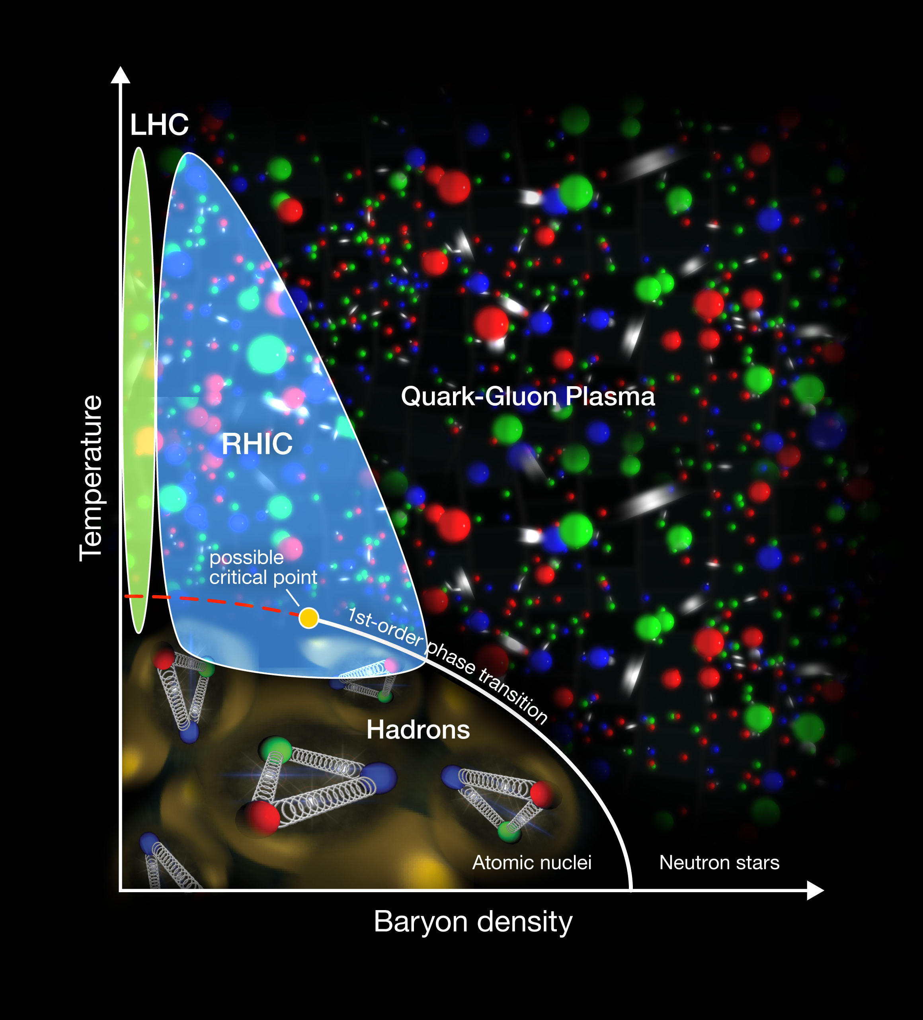
Quark-Gluon Plasma (QGP)
Continuous transition (crossover) between phases at zero baryon density ~ early universe
First order phase transition expected at finite baryon density
Transition from first order behavior to continuous behavior goes through a critical point
Temperature ~ 10¹² K

Slide 5
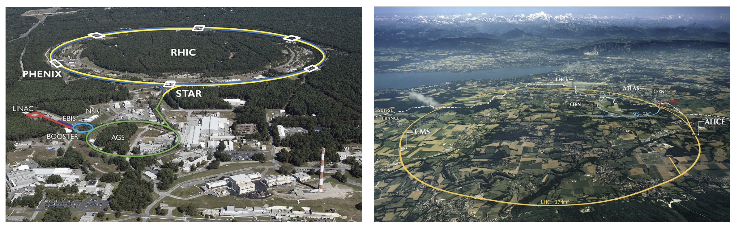
QGP Factories
s
Relativistic Heavy Ion Collider
√s_{NN} = 3 – 200 GeV (510 GeV for pp)
Collides p-p, p+Au, d+Au, Au+Au etc
Large Hadron Collider
√s_{NN} = 2.76, 5.02 TeV(13 TeV for pp)
Collides p-p, p+Pb, Pb+Pb, Xe+Xe etc

Slide 6
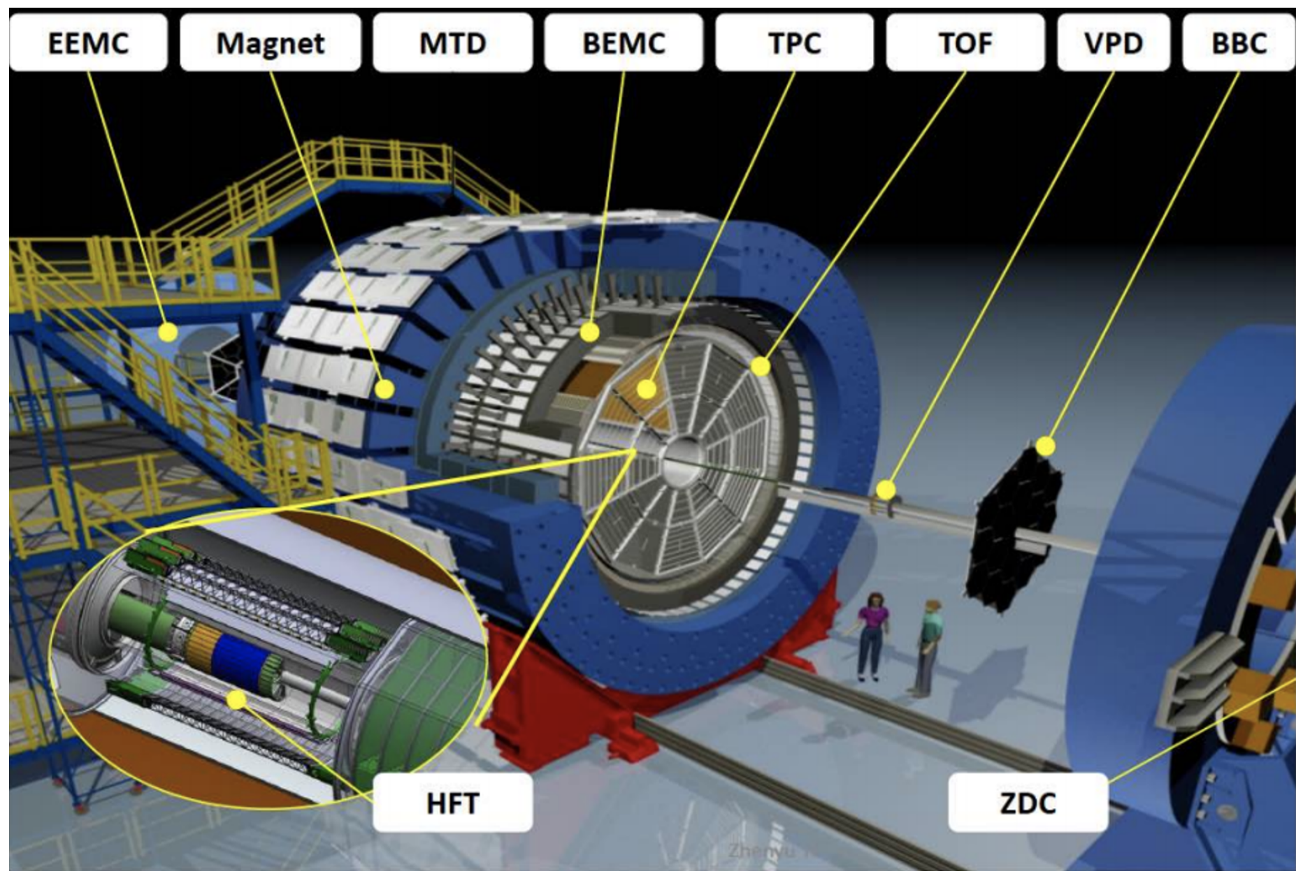
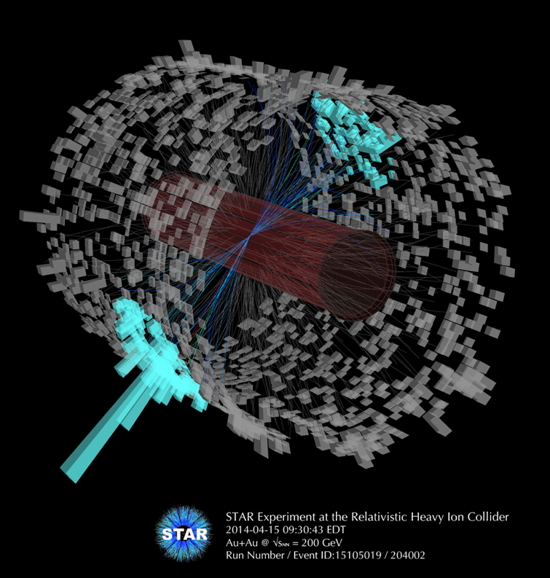
Apparatus
Capable of colliding both proton and heavy ion beams
Currently, the only running experiment is STAR, sPHENIX coming up soon
3.8 km long, has 6 intersection points
Notes:
This here is the Relativistic Heavy Ion Collider, home to the Solenoid Tracker at RHIC, better know as STAR experiment. RHIC is also the site for the upcoming Electron-Ion Collider facility, which has a long list of important physics goals, including a precise determination of the internal structure of the proton. The 3.8 km long ring at RHIC is capable of colliding protons at 510 GeV center-of-mass energy, and heavier nuclei at 200 GeV per nucleon center-of-mass energy. The STAR detector has many sub-detector systems. The important ones for our analysis are:
Time Projection Chamber: Measures momenta and track information, identifies charged tracks using ionization energy loss measurement
Time-of-Flight Detector System: Identifies particle using time of flight measurement
Heavy Flavor Tracker: Improves Position Resolution for secondary vertex measurement.
Now, let’s look at some preliminary results.

Slide 7
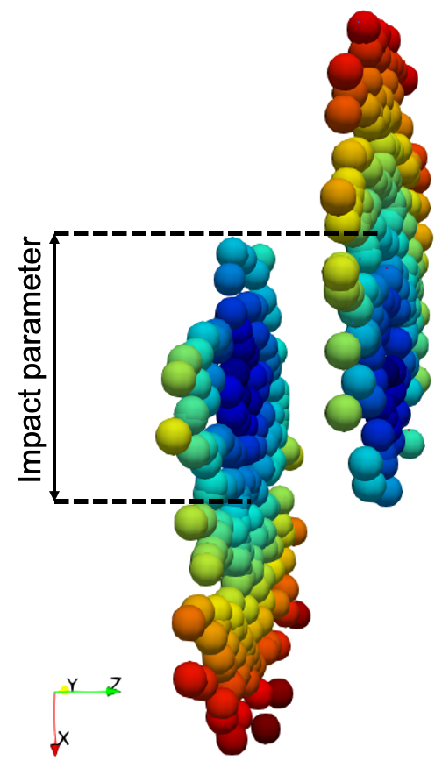
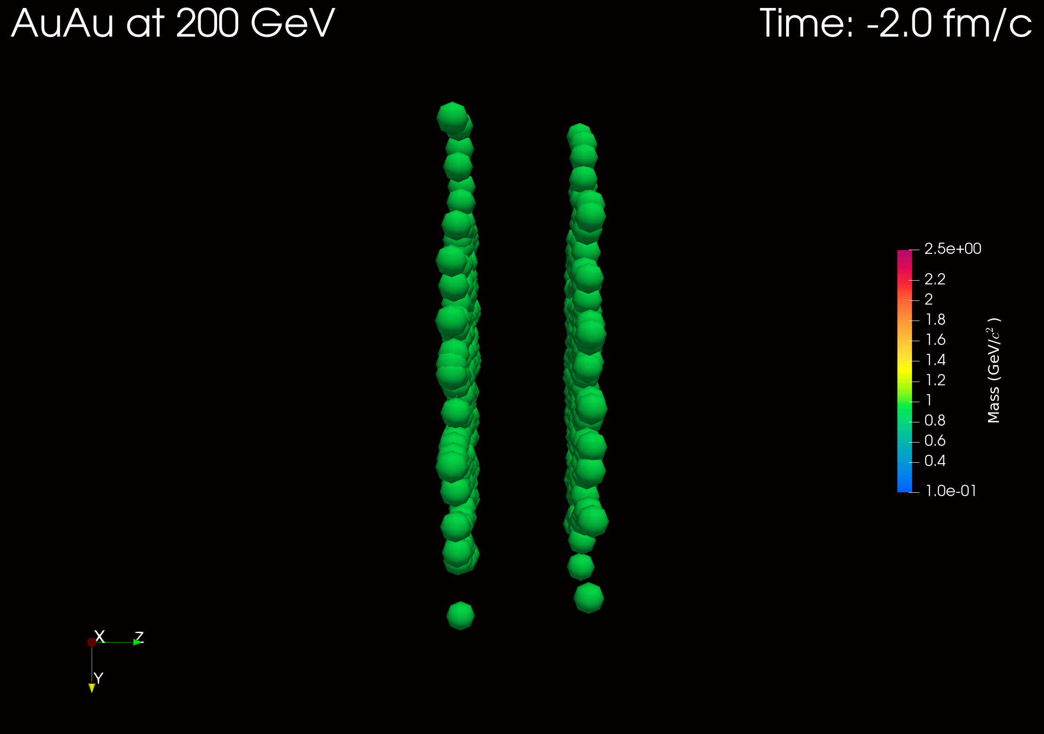
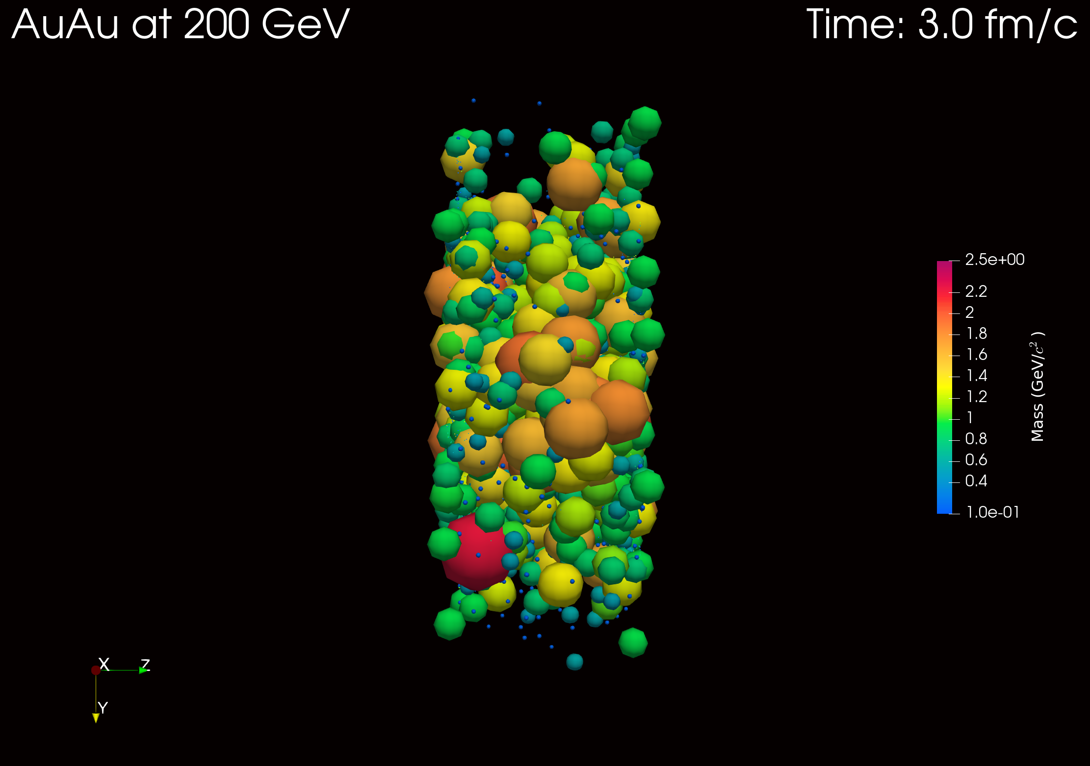
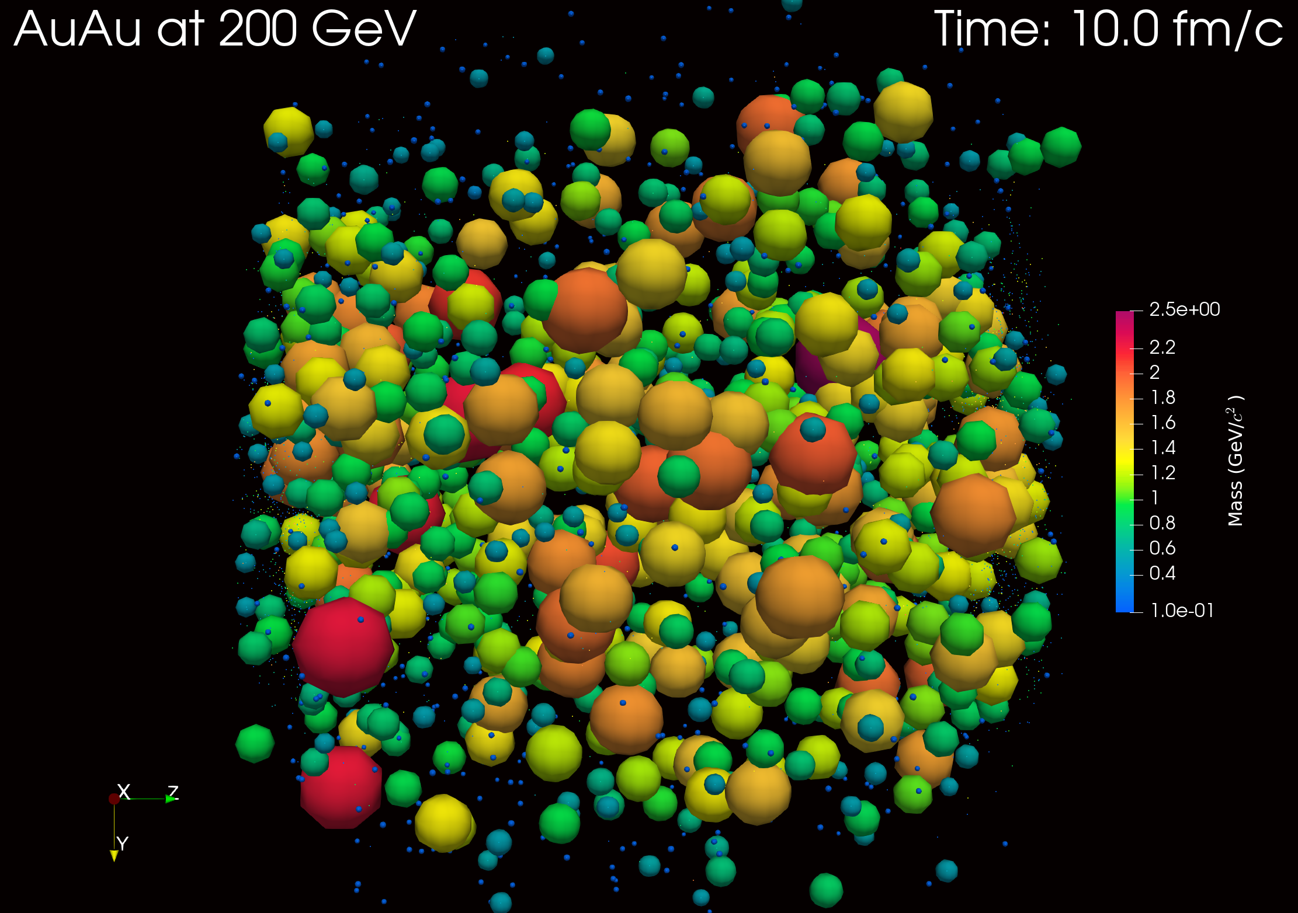
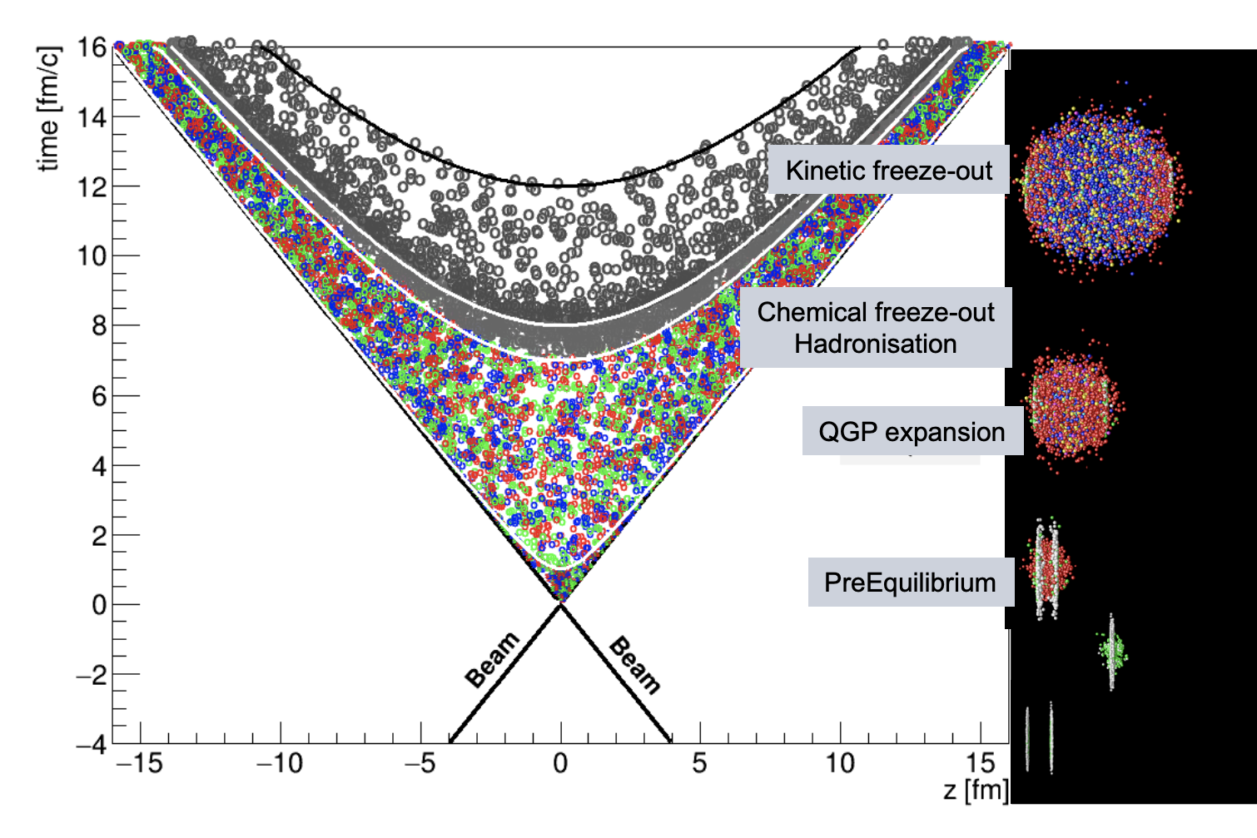
Heavy Ion Collisions
[SMASH] Phys.Rev.C 94 (2016) 5, 054905
Lorentz Contracted Nuclei (in the lab frame) collide, and form Quark-Gluon Plasma
New particle formation stops after the first few fm/c s
Ways to study the QGP
Bulk Probes
(Collective flow, critical point, freezeout parameters etc.)
Hard (Internal) Probes
(Jet modifications, heavy flavor production etc.)

Slide 8
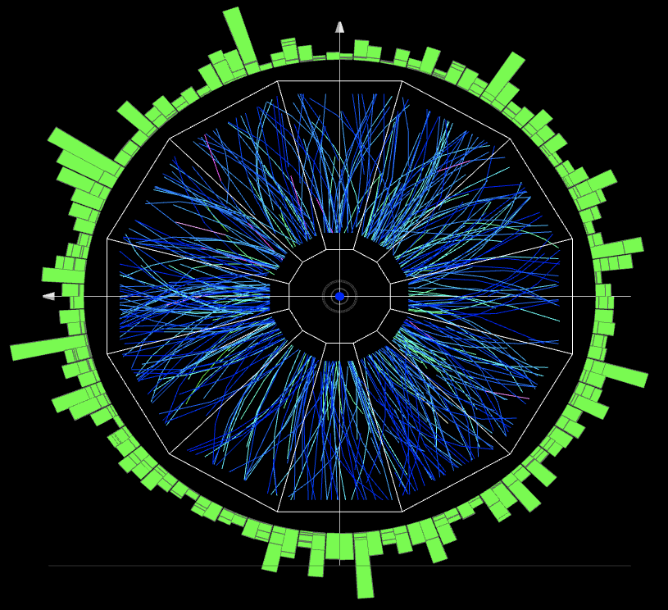
Bulk Probes
(Collective flow, critical point, freezeout parameters etc.)

Slide 9
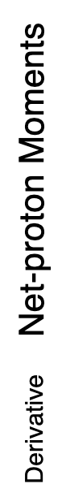
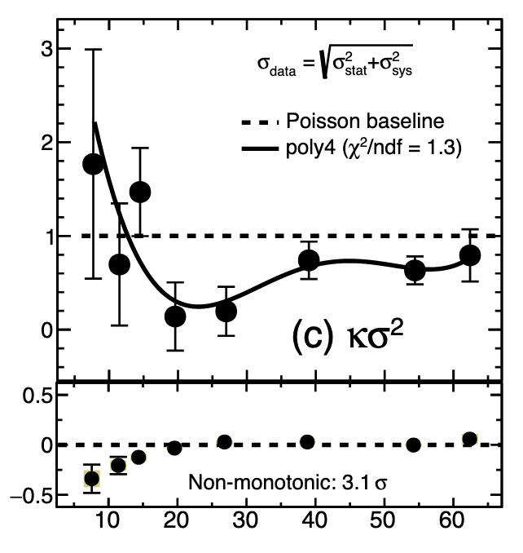
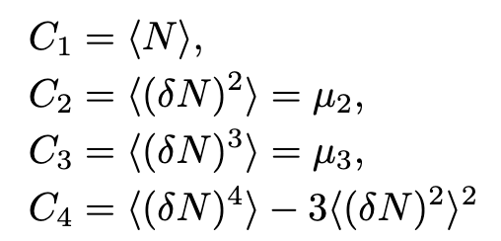

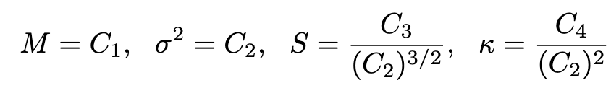


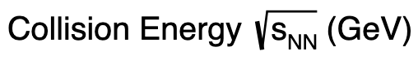
Search for the QCD Critical Point
Presence of a critical point: Difference in fluctuations of conserved charges in the hadronic phase vs deconfined phase
Fluctuations in net-baryon and net-charge → Quantified by the moments of the event-by-event distributions
STAR: arXiv 2101.12413 (2021)
Non-monotonicity in $κσ2$ with beam energy → Possible sign of critical point
Awaiting results from Beam Energy Scan II at RHIC

Slide 10
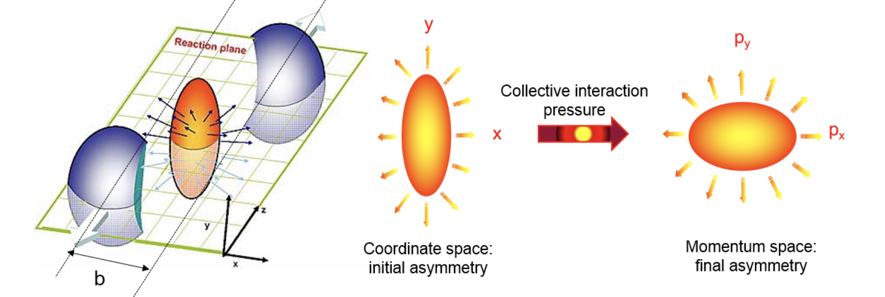
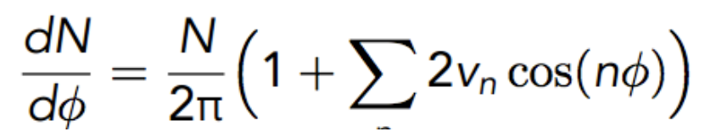
Anisotropic Flow
Quantify anisotropy with Fourier expansion

Slide 11
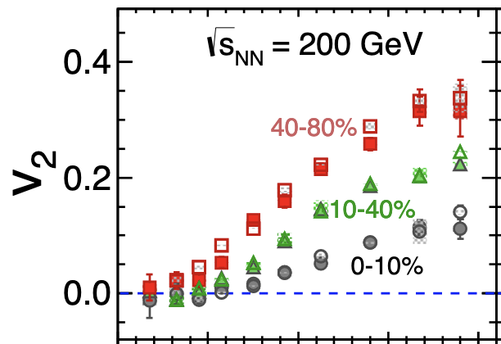
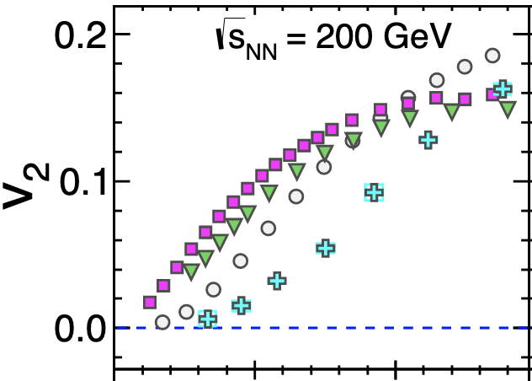
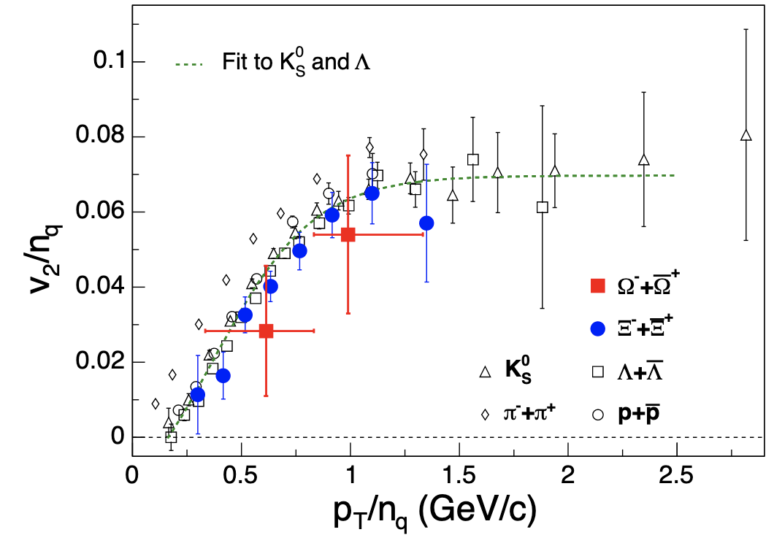
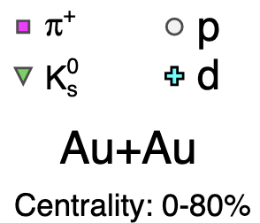
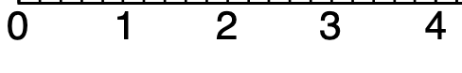

Anisotropic Flow
Au+Au 200 GeV
Au+Au
Au+Au
p_{T} (GeV/c)
p_{T} (GeV/c)
Flow increases for peripheral collisions where initial anisotropy is highest
Flow increases as a function of p_{T} → Hydrodynamic expansion of QGP
Flow for identified particles scaled by number of constituent quarks identical → Effects of flow sets in during the QGP phase

Slide 12
Anisotropic Flow
Au+Au 200 GeV
Au+Au
Au+Au
p_{T} (GeV/c)
p_{T} (GeV/c)
Flow increases for peripheral collisions where initial anisotropy is highest
Flow increases as a function of p_{T} → Hydrodynamic expansion of QGP
Flow for identified particles scaled by number of constituent quarks identical → Effects of flow sets in during the QGP phase

Slide 13
Anisotropic Flow
Au+Au 200 GeV
Au+Au
Au+Au
p_{T} (GeV/c)
p_{T} (GeV/c)
Flow increases for peripheral collisions where initial anisotropy is highest
Flow increases as a function of p_{T} → Hydrodynamic expansion of QGP
Flow for identified particles scaled by number of constituent quarks identical → Effects of flow sets in during the QGP phase

Slide 14
Hard (Internal) Probes
(Jet modifications, heavy flavor production etc.)

Slide 15
Hard Probes
How can we study the QGP properties?
Lifetime very short (O(1 – 10 fm/c))
Not feasible to use external probes
Instead, pass a QCD-sensitive internal probe through it, then look for any modifications due to the medium
One such probe is jets
Processes with:
Large momentum transfer (i.e., high Q²)
4. Measure an observable in p+p & p+A collisions
Measure the same observable in heavy ion collisions
Check for modifications
source: RHIC album © Brookhaven National Laboratory
Notes:
Now, to study the properties of Quark Gluon Plasma, we cannot rely on internal probes as the lifetime of QGP is very short. Instead, we look for an internal probe which is sensitive to the QGP medium i.e. has a significant interaction with the medium. These include processes with large momentum transfer. The measurement of an observable in the proton-proton and proton-heavy ion collisions acts as our baseline measurement. We then look for modifications to the same observable in heavy ion collisions where a significant amount of QGP is formed. Such modifications can shed light on various properties of the QGP.
One such probe that we use is Jets. Jets are these collimated cluster of particles fragmenting from a high momentum quark or gluon. Quark and gluons can’t remain unbounded and fragment into particles via radiation. These particles have momenta in similar direction. Experimentally, we use a jet reconstruction algorithm, which uses some form of distance measure to cluster such particles that move in the same direction. This is an event display of two jets in the STAR detector., shown by their deposits in the calorimeter.

Slide 16
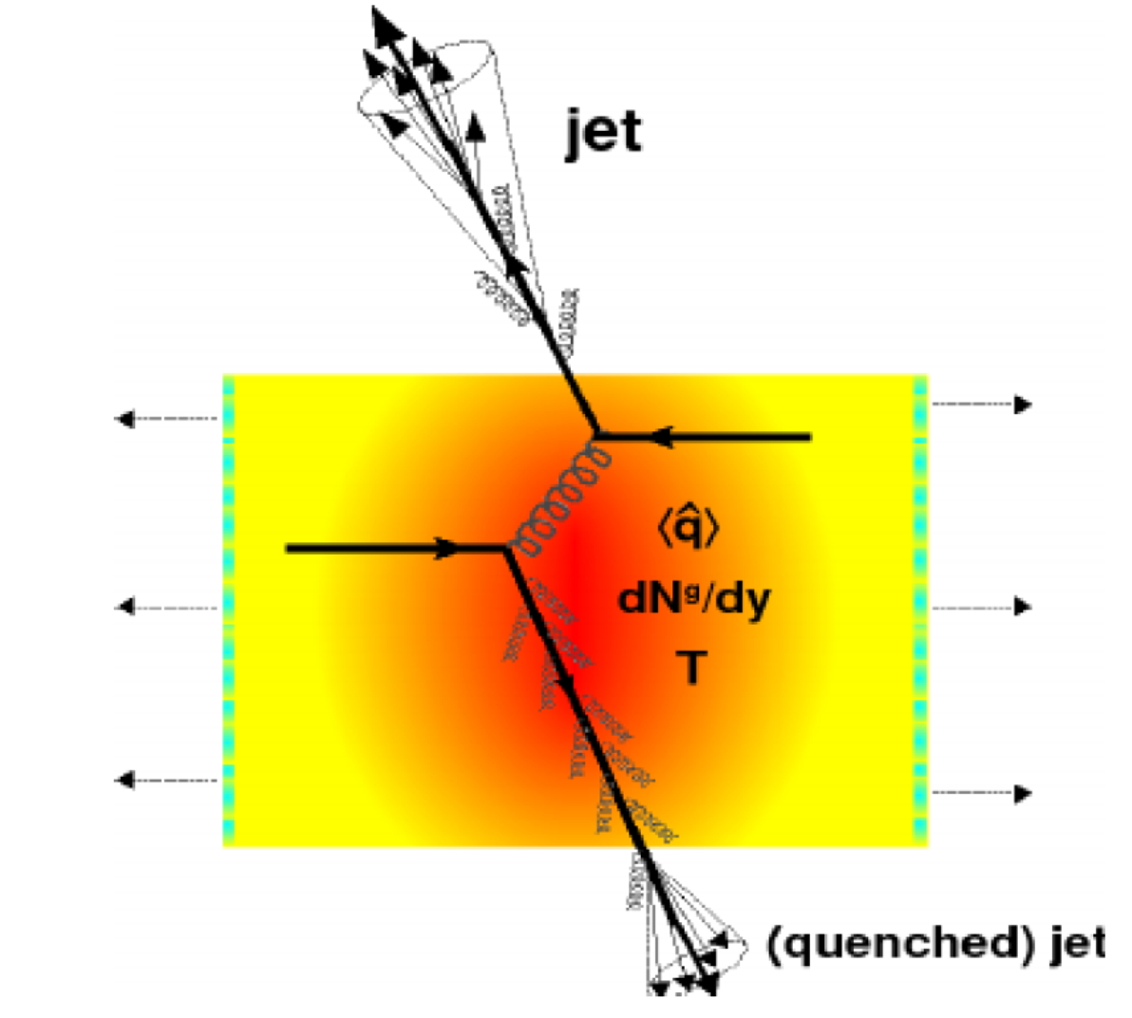
Jets
“Jets” are generated after collisions between hard scattered quarks and gluons (partons).
Outgoing quark or gluon “fragments” into a spray of particles.
Algorithm clusters tracks and energy depositions using a “distance measure” to cluster softer particles around high p_{T} particles.
We look at jet observables in pp collisions and compare them to heavy ion collisions to see the effects of the QGP.

Slide 17
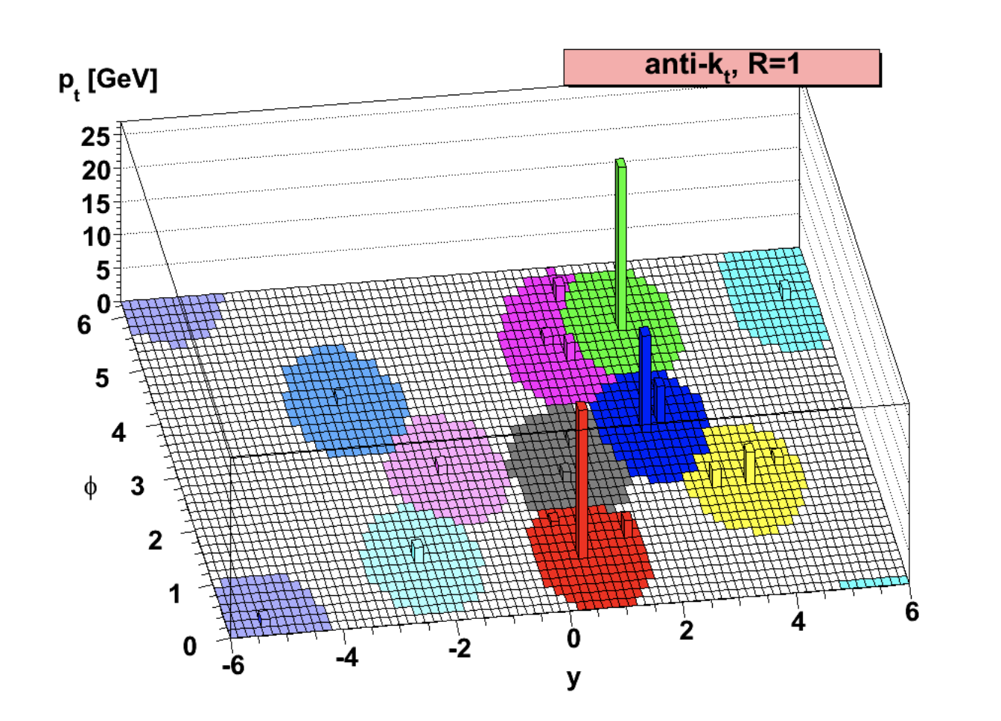
Reconstructing Jets in an Experiment
Anti-k_{T} jet clustering algorithm used through the FASTJET package (Phys. Lett. B 641 (2006) 57-61)
Sequentially clusters softer detected entities (charged particle tracks and calorimeter energy depositions) around harder entities
Creates approximately conical jets with radii determined by the jet resolution parameter (R)
R fixed based on various experiment specific considerations

Slide 18
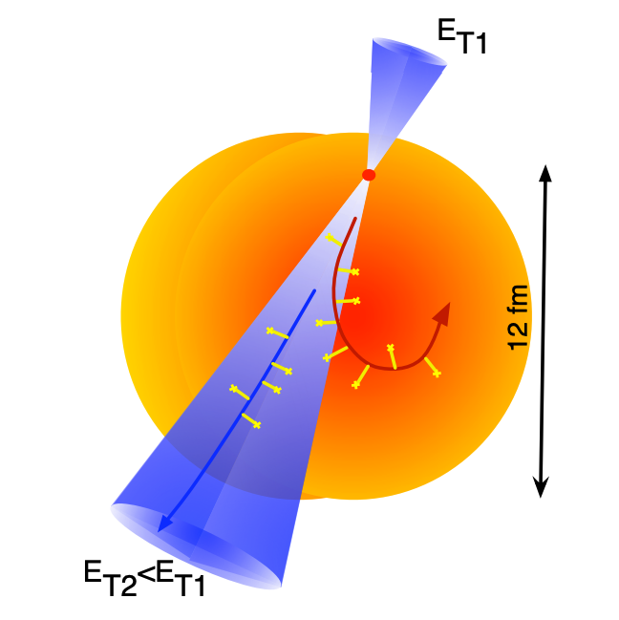
Jet Quenching
q
q
p + p
A + A
Notes:
This plot shows the azimuthal correlation of hadrons with a high transverse momenta hadron in the system (which was used as a proxy for jets back in 2005). The black points correspond to the measurements from pp collisions, the red from deuteron gold collisions, and the blue from gold gold collisions. What we see is that in pp, dAu , and AuAu collisions, we have a peak in the correlation at 0 degrees. The peak, however, is remarkably absent at phi equals 180 degrees in AuAu collisions. That is not the case for proton proton or deuteron gold collisions. This result confirmed that jets are quenched in the medium. Now, before we proceed, I would like to talk about jets which arise from charm quarks. Transition to next slide.

Slide 19
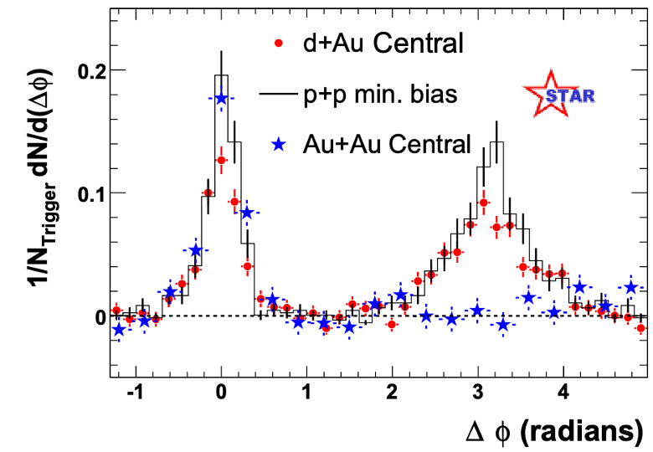
Jet Quenching
STAR, Phys. Rev. Lett. 91 (2003) 072304
q
q
p + p
A + A
Far side jets are heavily suppressed in the medium.
Notes:
This plot shows the azimuthal correlation of hadrons with a high transverse momenta hadron in the system (which was used as a proxy for jets back in 2005). The black points correspond to the measurements from pp collisions, the red from deuteron gold collisions, and the blue from gold gold collisions. What we see is that in pp, dAu , and AuAu collisions, we have a peak in the correlation at 0 degrees. The peak, however, is remarkably absent at phi equals 180 degrees in AuAu collisions. That is not the case for proton proton or deuteron gold collisions. This result confirmed that jets are quenched in the medium. Now, before we proceed, I would like to talk about jets which arise from charm quarks. Transition to next slide.

Slide 20
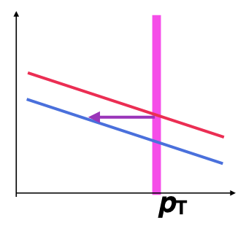

Jet Quenching
Peripheral
Central
A + A
(Central)
R_{CP} =
Binary collision scaled
$$⨂$$
(Peripheral)

Slide 21
Jet Quenching
Peripheral
Central
A + A
(Central)
R_{CP} =
Binary collision scaled
$$⨂$$
(Peripheral)

Slide 22
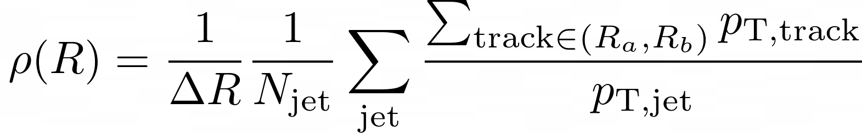
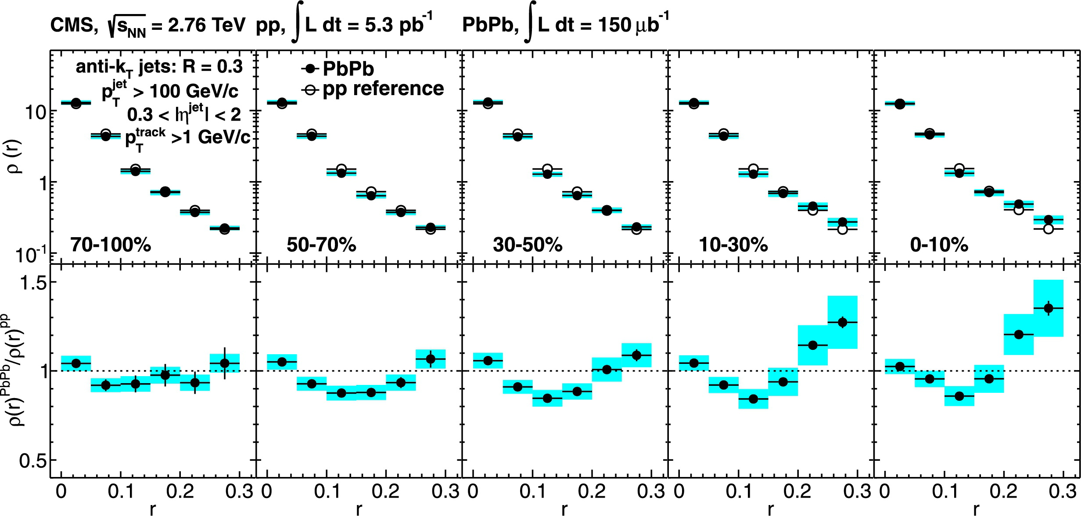
Jet Broadening
Differential jet shape
Decreasing centrality
CMS, Phys. Lett. B 730 (2014) 243
The jet energy is redistributed inside the jet cone in the presence of QGP at the LHC.
Notes:
This analysis at LHC energies shows the centrality dependent ratio of the differential jet shape in heavy ion collisions and proton proton collisions. The solid circles are for lead lead, and the open circles are for proton proton collisions. We go from more central to more peripheral from right to left. The jet momenta and hence energy in jets in central collisions is found to be depleted at intermediate radii and redistributed at larger radii from the jet axis when compared to pp collisions, meaning the jets are more diffused in central HI collisions. These behavior is no longer observed in peripheral collisions where the volume of QGP created is small. We want to look at the differential jet shape modifications for charm quark jets and look for any such differences.

Slide 23
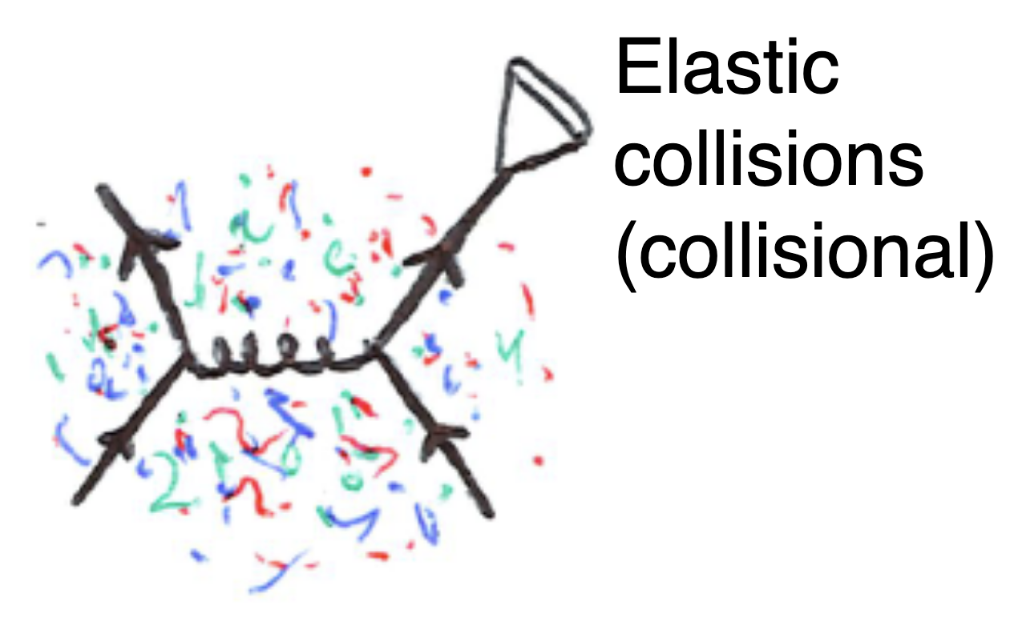
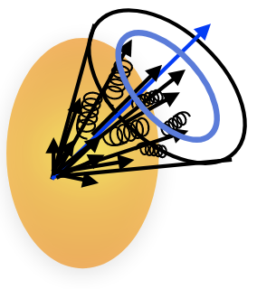
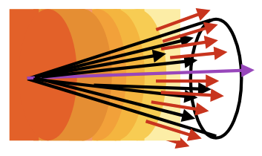
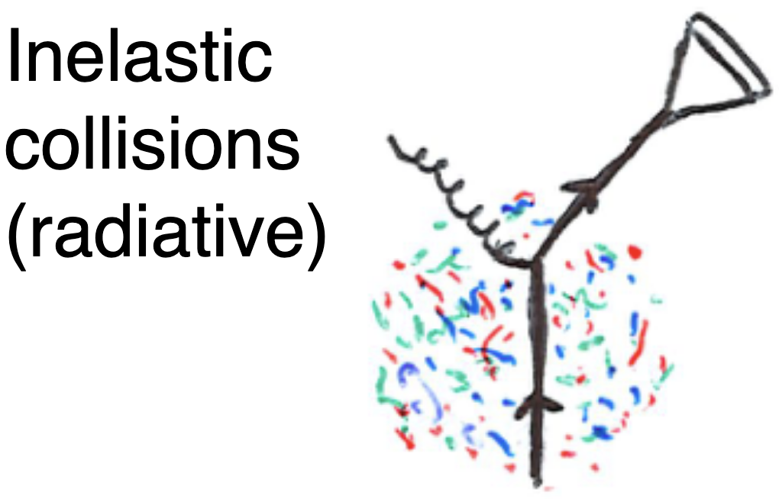
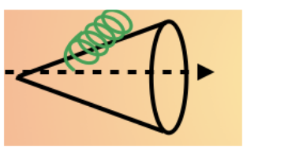
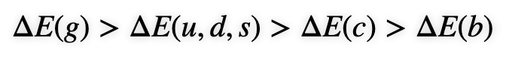
Jet Medium Interactions
Multiple scattering
Images from Laura Havener, Yale
Broadens and
Quenches jets
Medium Response
Dependent on the mass of the underlying quark
Medium-induced splittings

Slide 24
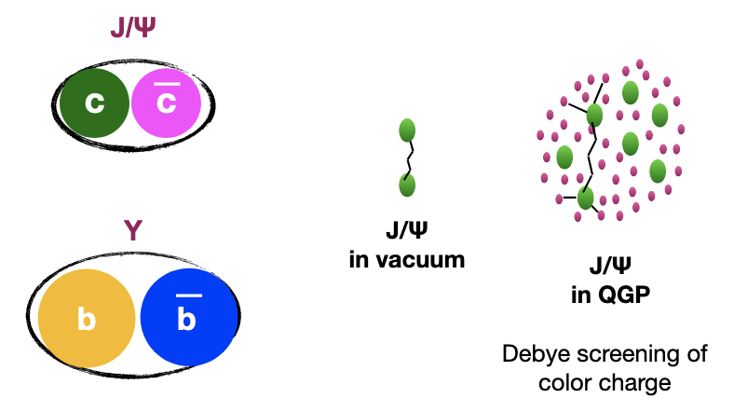

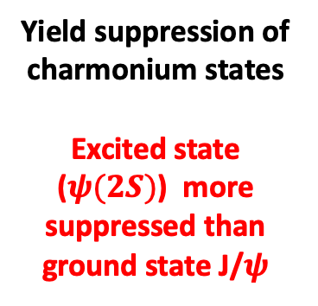
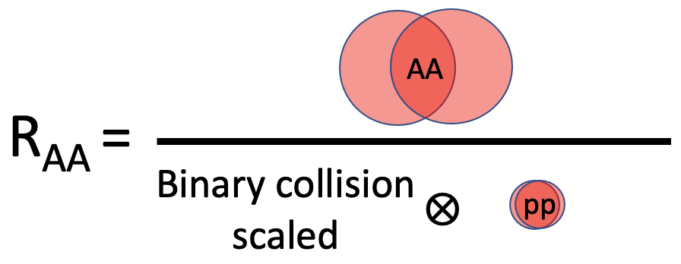
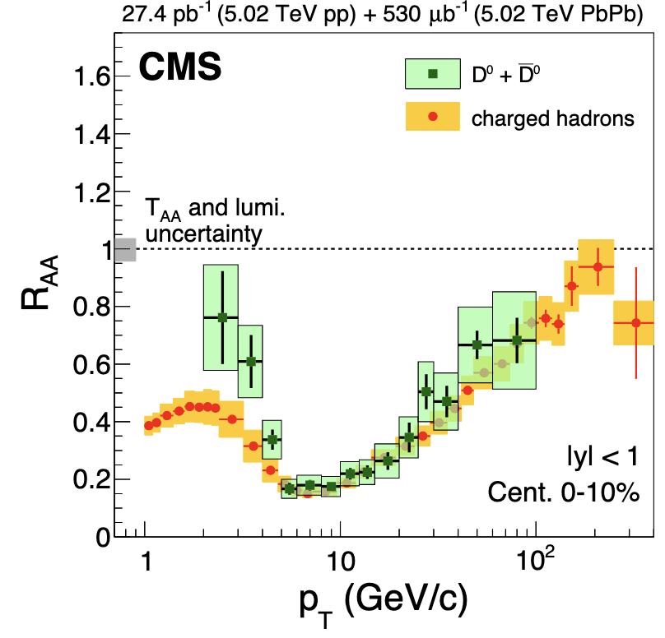
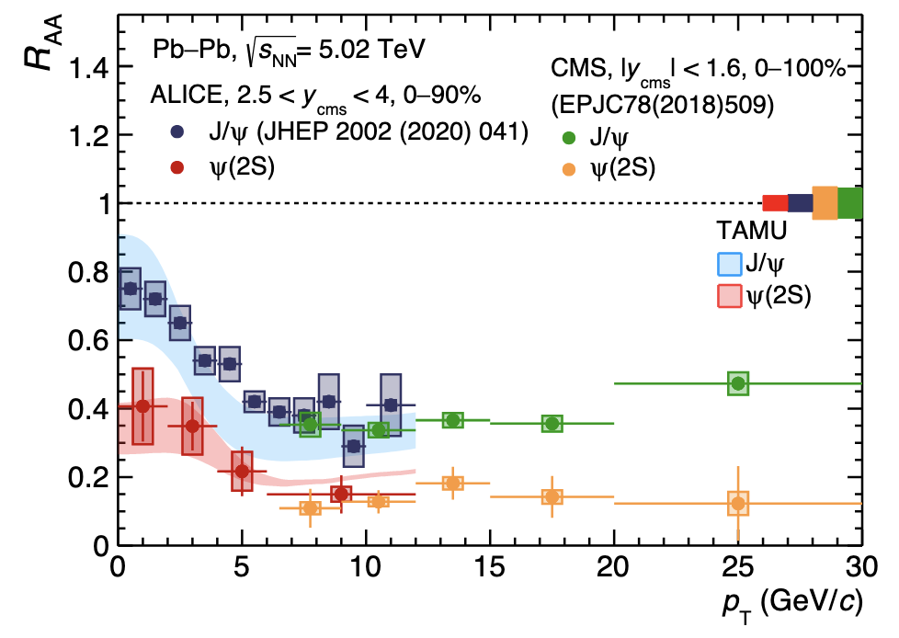
Heavy Quarks (Charm) in Medium
Open heavy flavor
Quarkonia
CMS, arXiv:1708.04962
ALICE, arXiv:2210.08893
Yield suppression of charmonium states
Excited state ($ψ(2S)$) more suppressed than ground state J/$ψ$
Charm mesons less suppressed than charged hadrons at low p_{T}

Slide 25
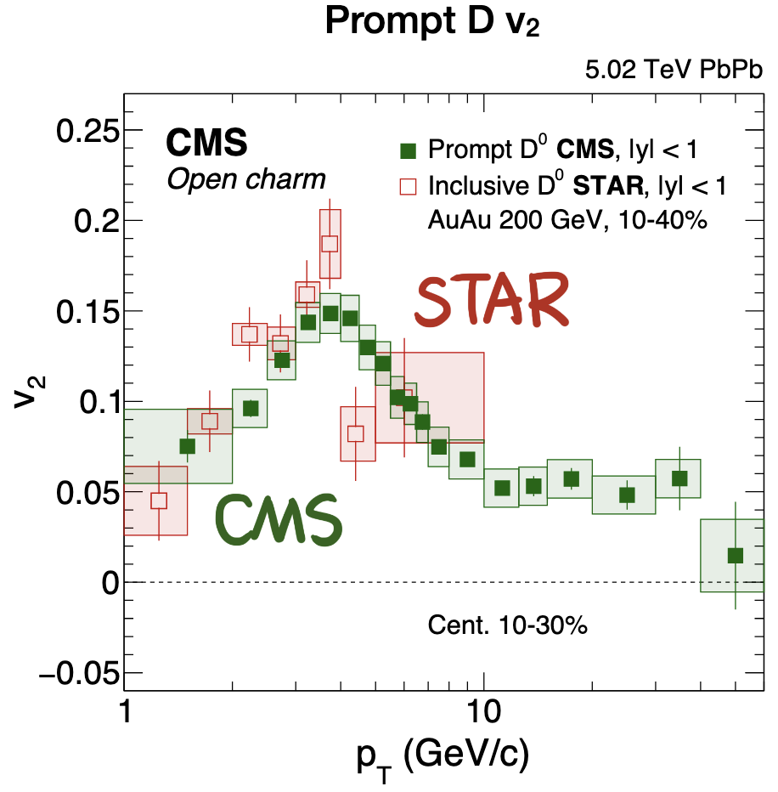
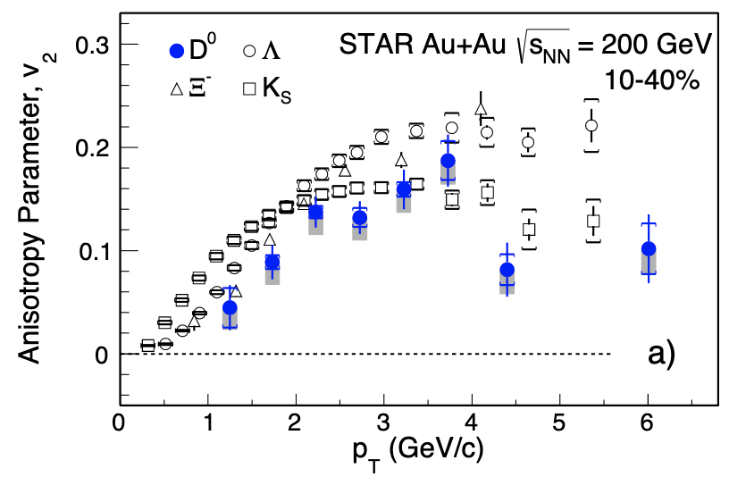
Charm Quark Anisotropy
STAR, arXiv: 1701.06060
Jing Wang @ HF-WINC2020
Charm quarks interact strongly with the medium and participate in collective expansion → Non-zero flow
At RHIC energies, open charm quark exhibits similar collective behavior as light hadrons

Slide 26
Open Charm Jets – Looking at the ‘dead cone’
ALICE, arXiv:2106.05713 (2021)

Slide 27
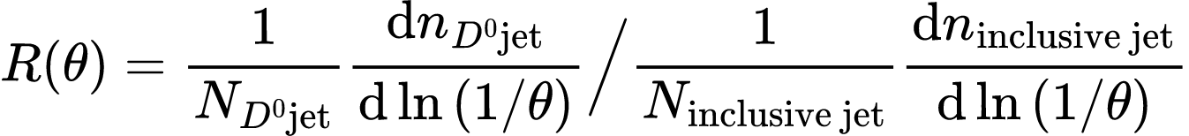
Open Charm Jets – Looking at the ‘dead cone’
ALICE, arXiv:2106.05713 (2021)
Large angle
Small angle
Heavy-flavor emission spectra at small angles suppressed due to dead-cone effect

Slide 28
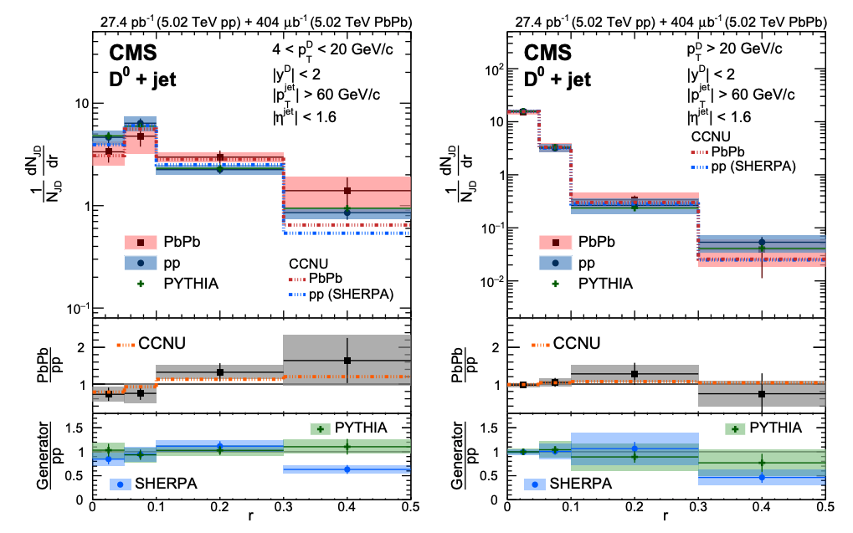
Open Charm Diffusion in Jets (5 TeV)
CMS, Phys. Rev. Lett. 125 (2020) 102001
Low p_{T} D⁰ mesons appear to be diffused in the presence of QGP at LHC
Lower p_{T} D⁰ mesons can be reconstructed at RHIC energies
Contribution from the underlying background is smaller at RHIC
Notes:
Another analysis at LHC energies shows the radial distribution of D0 mesons in jets. The ratio of the PbPb and pp distributions are shown in the middle panel. The results are presented in two D0 transverse momenta ranges. Low transverse momenta D0s are probably slightly more diffused in heavy ion collisions than in pp collisions. This effect vanishes at higher transverse momenta. This result is at least qualitatively different from other existing results which suggest that low momenta tracks are usually closer to the jet axis in heavy ion collisions. This is at LHC energies, so we want to perform a similar study in the lower RHIC energy regime where this low pT region might be better accessible. The bottom panel shows the ratio between the results from PYTHIA and from pp collision data at LHC, and the key takeaway is that PYTHIA can explain the results from pp pretty well.
Now, before moving on, let us take a look at our experiment.

Slide 29
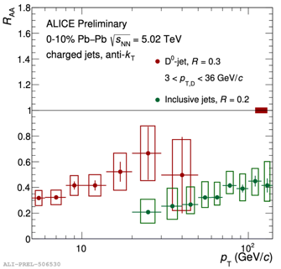
Open Charm Jets in Medium (Quenching)
Strong in-medium suppression for D⁰-tagged jets at low p_{T,jet} at 200 GeV from STAR and 5.02 TeV from ALICE

Slide 30
Open Charm Diffusion in jet (5 TeV)
No diffusion observed with D0 p_{T} > 5 GeV

Slide 31
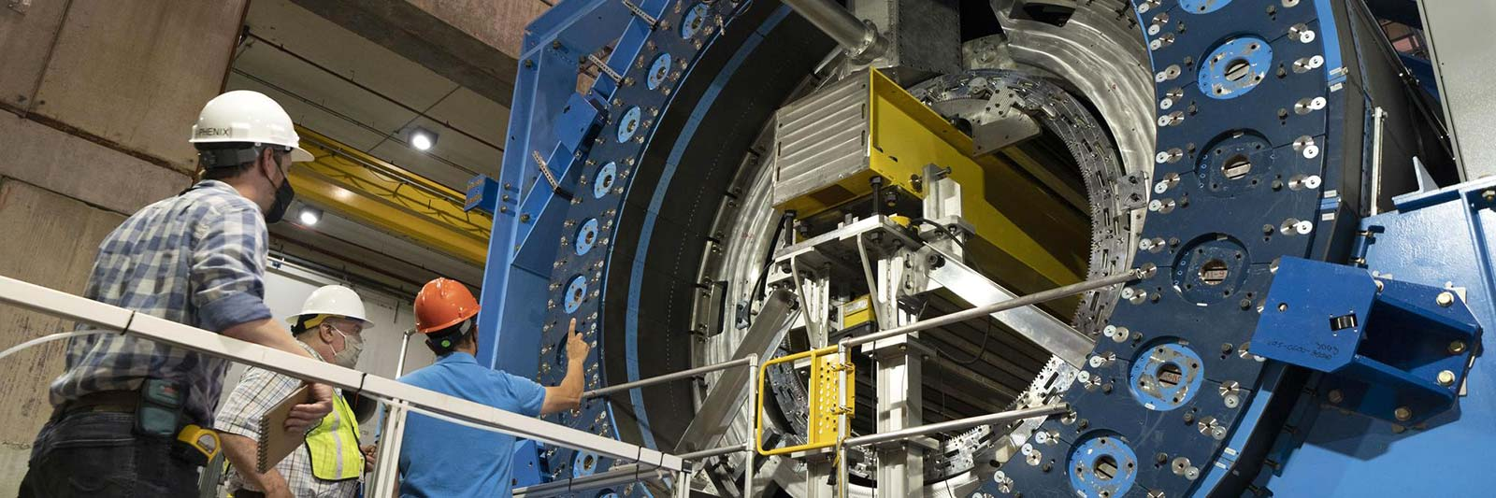
Summary
Probes of quark-gluon plasma come in all shapes, sizes, color, and flavor
Beam Energy Scan II at STAR is hunting for the ever-elusive critical point
Army of unique and complimentary hard probes at our disposal at LHC and RHIC
Heavy flavor jets offer a unique perspective into the mass and flavor dependence of interactions with QGP
NEW DETECTOR AT RHIC: sPHENIX Precision measurements of heavy flavor

Slide 32


Slide 33
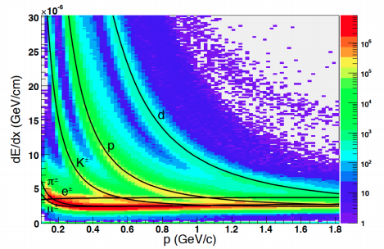
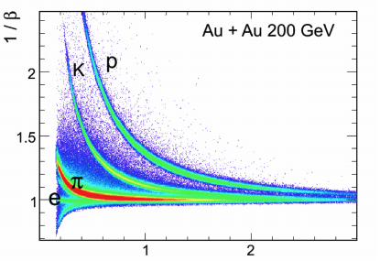








D⁰ Reconstruction
Particle Identification
TPC
TOF
Au+Au $√s_{NN}$ = 200 GeV, Run14
Au+Au $√s_{NN}$ = 200 GeV, Run14
$−\left\langle \frac{dE}{dx}\right\rangle$ $∝\frac{m^{2}}{p^{2}}$
$$β=\frac{L}{cτ}$$
|n$σ_{π}$| < 3.0
|n$σ_{K}$| < 2.0
$|\frac{1}{β} − \frac{1}{β_{exp}}|$ < 0.03
Hybrid PID to identify Pions and Kaons to reconstruct D⁰ mesons
Notes:
To identify D0 candidates, we need to identify the daughter kaons and pions. This plot here shows the ionization energy loss for different species of particles as measured by the TPC. TPC cannot resolve the kaon pion bands very well above transverse momenta of 0.6 GeV. TOF, with its time-of-flight measurement offers better separation of the Kaon and Pion bands. To suppress the background, some topological cuts based on the decay geometry are applied to the D0 candidates. That is possible due to the Heavy Flavor Tracker Detector, which we talked about earlier. The resolution of HFT makes it possible for us to constrain Kpi candidates based on their decay kinematics.
We show the invariant mass of the Kaon Pion pairs for the peripheral AuAu collisions at STAR within the denoted acceptance region. To estimate the yield, we fit a gaussian to the signal and a second order polynomial to the background. This is the raw yield, and it needs to undergo some corrections.

Slide 34



D⁰ Reconstruction
Improving signal significance
STAR, Phys. Rev. C 102 (2020) 014905
~ 30 μm
~ 250 μm
~ 300 μm
~ 1 mm
TPC Tracks
Decay Length of D⁰ ~ $123 μm.$
HFT has a resolution of $30 μm$ for kaons at ~ 1.2 GeV/c
HFT can reconstruct D⁰ candidates based on the decay kinematics
Topological cuts on the D⁰ candidates improve signal significance

Slide 35



D⁰ Reconstruction
Au+Au $√s_{NN}$ = 200 GeV , Run14
STAR, Phys. Rev. C 99 (2019) 034908
STAR
D⁰ yield corrected for reconstruction efficiency
The efficiency weights were derived using a data-driven fast simulation method

Slide 36


Fragmentation Function In PYTHIA8
Fragmentation function: Related to cross-section of production processes
In experiment, $z= \frac{{\vec{p}}_{T,{ D}^{0} }. {\hat{ p}}_{T,Jet}}{{|\vec{p}}_{T,Jet}|}$
X
Ratio of reweighted and original response matrix
Low p_{T} particle level jets pick up huge weights → Bias in response matrix
NEED FIXING

Slide 37
Summary and Outlook
First measurements of D⁰ meson jet p_{T} spectra and radial distribution of D⁰ mesons in jets for peripheral collisions.
PYTHIA simulation along with existing data-driven fast simulation method used to estimate detector effects.
2D Unfolding used to correct the radial distribution of D⁰ mesons
Need a way to correct for the fragmentation function discrepancy
Official simulation sample on the way to validate the current results for QM
R_{CP} values will be reported with the official sample
THANK YOU

Slide 38

Backup

Slide 39
Backup
CMS, JHEP 05 (2018) 006

Slide 40

Backup

